Slide 1
JavaServer Faces (JSF) Fundamentals
An overview of core concepts, lifecycles, and best practices

Slide 2
What is JSF?
A Java-based web framework for building component-driven UIs
Part of Java EE (now Jakarta EE)
Simplifies MVC architecture with reusable UI components

Slide 3
Merits and Demerits of JSF
Merits:
- Component-based: promotes reuse
- Integrated with Java EE: built-in support for validation, navigation
- Rich set of UI libraries (PrimeFaces, RichFaces)
Demerits:
- Can be heavyweight: learning curve, performance overhead
- Complex configuration in early versions

Slide 4
JSF Lifecycle
1. Restore View: Build component tree
2. Apply Request Values: Populate components
3. Process Validations: Convert & validate data
4. Update Model: Push values to backing beans
5. Invoke Application: Execute actions
6. Render Response: Generate HTML output

Slide 5
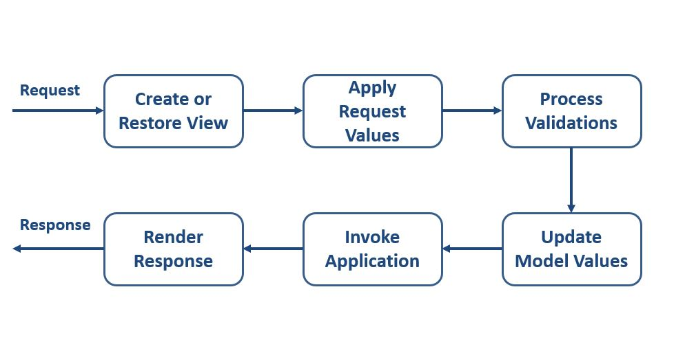
JSF Lifecycle

Slide 6
Features of JSF
UI Component Model: built-in & custom tags
Managed Beans: Java objects as controllers
Navigation Handling: XML or annotations
Event Handling: Listeners & Ajax support
Templating: Facelets for view composition

Slide 7
Managed Bean in JSF
A Java class annotated (@ManagedBean) or CDI (@Named)
Holds UI state & action methods
Configured via annotations or faces-config.xml

Slide 8
Bean Scopes in JSF
@RequestScoped: per HTTP request
- Lightweight, no state retention
@ViewScoped: per view, survives postbacks
- Maintains state within same page
@SessionScoped: per user session
- Good for multi-page flows, memory cost
@ApplicationScoped: shared across all users
- Global config, be cautious with state

Slide 9
AJAX in JSF
AJAX = Asynchronous JavaScript and XML
Benefits:
- Partial page updates, improved UX
- Reduced bandwidth usage
Using AJAX in JSF:
<p:ajax> tag for event-based updates
Built-in support in PrimeFaces, RichFaces

